Slide 1
Crimes in Boston
ALY6040: Data Mining Applications
Mr. Joseph M. Reilly
College of Professional Studies
Aayushi Gupta
Atharva Shantanu Kulkarni
Dhwani Patel

Slide 2
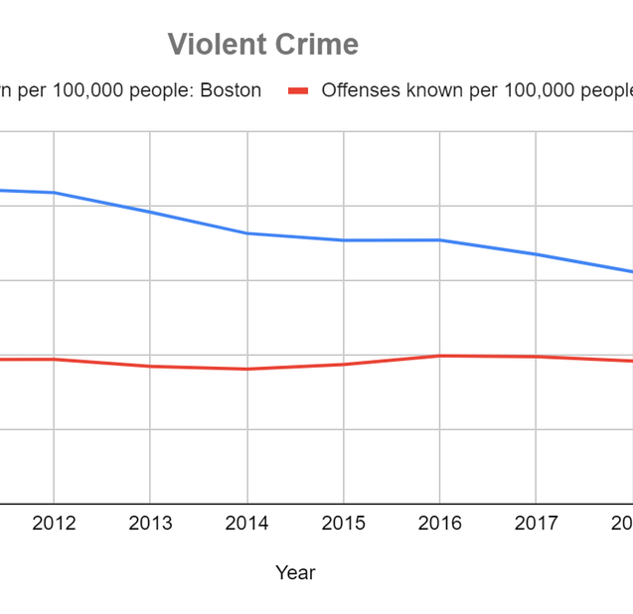
Business Problem
Increasing number of crimes
Ineffective and time taking crime solving methods
Goal: Identify factors affecting crime and eventually make a scalable model
Relationship between predictors and type of crime
Approach taken: treat every data point individually and use timestamps and location coordinates as separate features

Slide 3
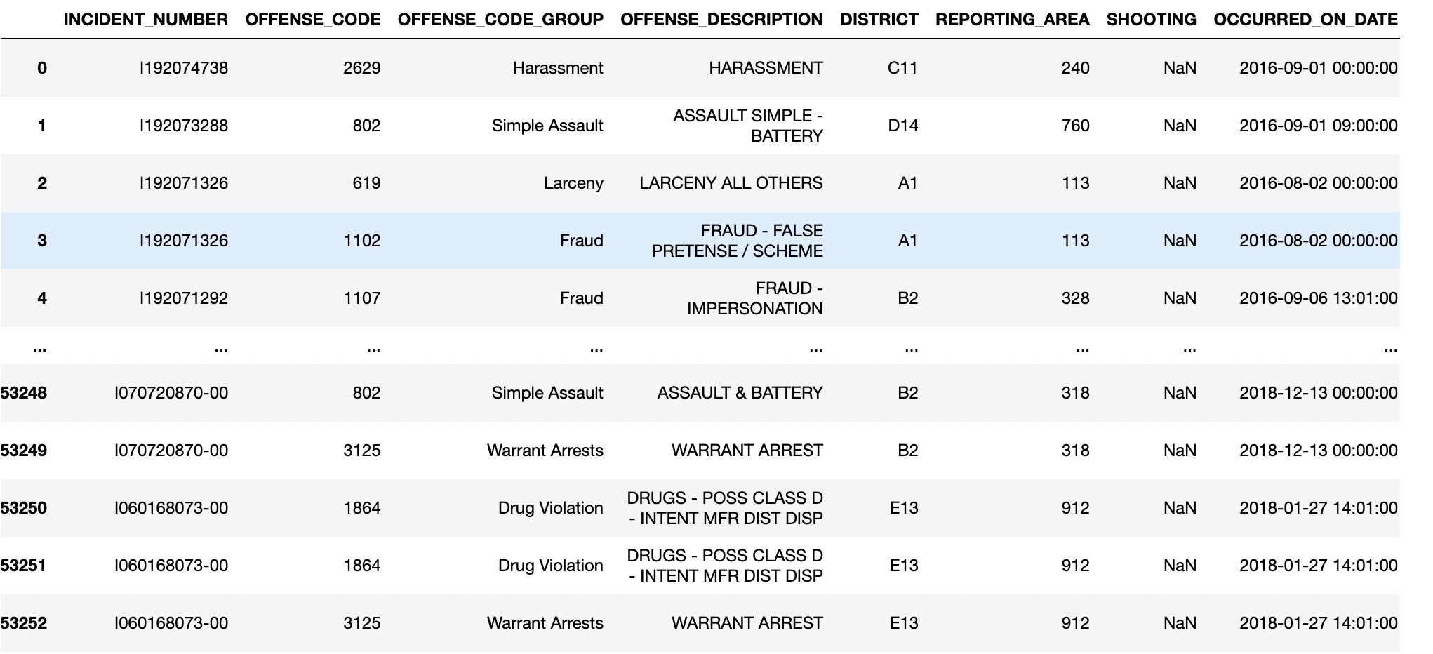
Data Description
Data Source: Crime Incident Reports from Analyze Boston provided by BPD from the years 2015-2018
Number of data points: 353253 Number of variables: 17
Target Variable: OFFENSE_CODE_GROUP
----UCR Crimes----
Bias: Untracked crimes have
not been logged

Slide 4
Data Preprocessing
Drop unnecessary columns
Deal with the missing values
Check for duplication
Treat outliers
Covert datatypes of columns into the required format
Integrate weather data

Slide 5
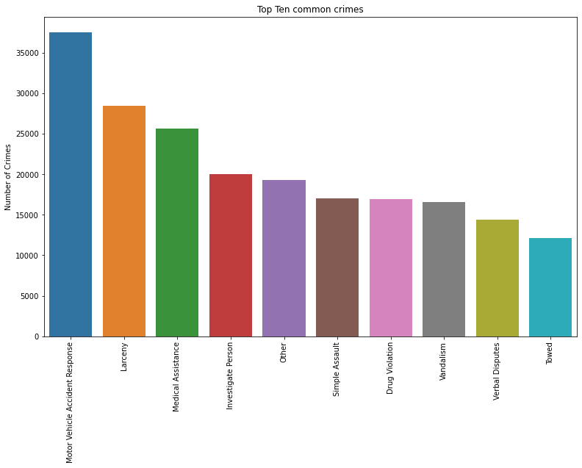
Exploratory Data Analysis

Slide 6
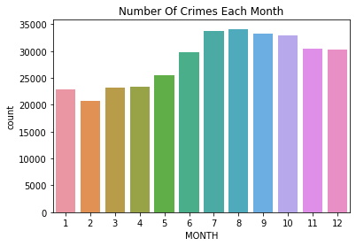
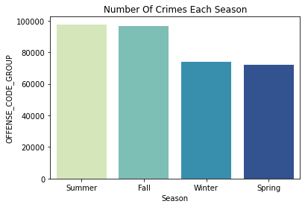
EDA (continued)…

Slide 7
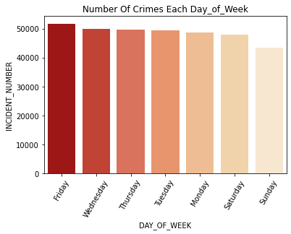
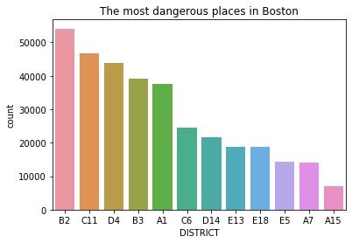
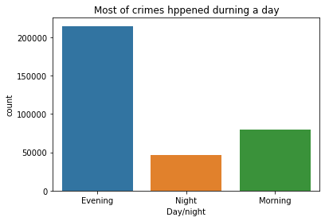
EDA (Continued)…

Slide 8
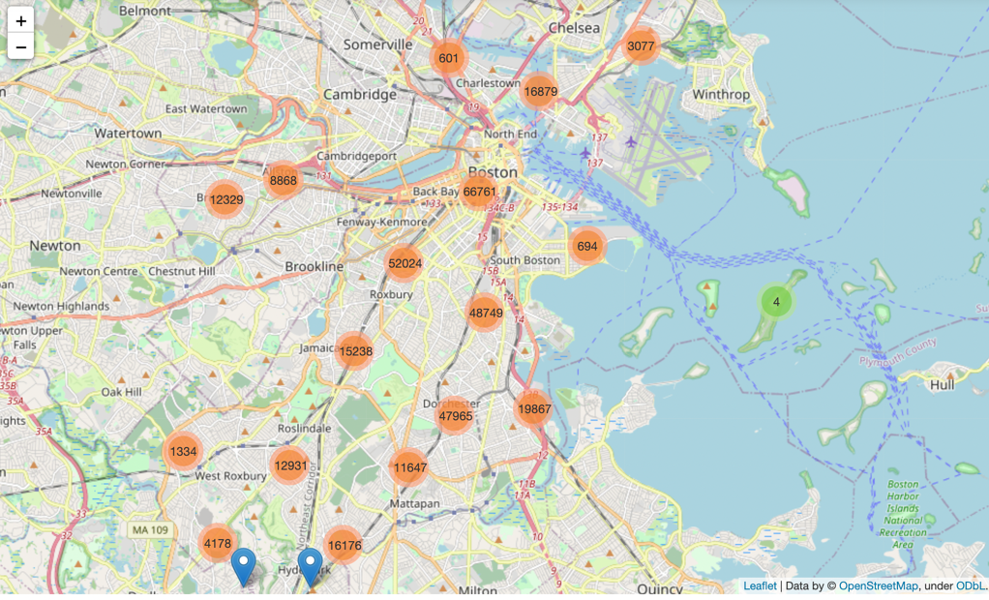
EDA (Continued)…

Slide 9
Data Modeling
Random Forest
By utilizing many trees, the random forest method avoids and prevents overfitting.
Results are known to be more accurate
Efficiently handle large datasets
Performance on training set: 96.6%
Performance on testing set: 78.62%
Hyperparameters after tuning:
{'n_estimators': 1342,
'min_samples_split': 30,
'min_samples_leaf': 1,
'max_depth': 100,
'criterion': 'entropy’,
'bootstrap': True}
Accuracy: 80.63%

Slide 10
Data Modeling(continued…)
Decision Tree:
Uses a white-box model.
The cost of using the tree (i.e., predicting data) is logarithmic in the number of data points used to train the tree.
Ability to using different feature subsets and decision rules at different stages of classification
Performance on training set: 96.62%
Performance on testing set: 69.24%
Same set of hyperparameters as random forest were used to tune the model and accuracy increased to 71.23%.

Slide 11
Data Modeling (continued)…
KNN
The calculation time is quick
Simple to interpret
A lazy learner.
Data can be easily added.
Easy to implement
Performance on training set: 82.61%
Performance on testing set: 77.47%
Hyperparameters after tuning:
Best leaf_size: 1
Best p: 1
Best n_neighbors: 25
New Accuracy: 80.48%

Slide 12
Conclusion
Unbalanced data creates a problem in binary classification data
Best Performing model: Random Forest with an accuracy of 80.63%
Further evaluation after unbalanced data has been treated, would be beneficial in yielding significant improvements
Model | Accuracy | Precision | Recall
Decision Tree | 71.23% | 0.22 | 0.23
KNN | 80.48% | 0.32 | 0.01
Random Forest | 80.63% | 0.53 | 0.01

Slide 13
Next Steps
Using some other complex but efficient models like XGBoost classifier to further improve performance.
Integrate More features in the dataset: street lighting, proximity to a police station, median household income of the residents in that area, race of the people living in the area, and the poverty rate.
Deal with Bias in the data

Slide 14
THANK YOU!

